Slide 1


Your Ultimate Tour and Travel Web Guide
Presented by
Nayma Sultana(2154901072)
Amena Ansari Bela(2154901076)
Subhanwita Dey swasty(2154901078)

Slide 2

Introduction
We aim to create a travel management system that focuses on all the lesser-known tourist attractions of our country. Through this platform, we aspire to offer a unique experience to travel enthusiasts, bringing them closer to the heart of the country and unveiling the beauty of these hidden attractions.

Slide 3
Objectives
1
2
5
Exclusive Deals and Offers
Curate Personalized Itineraries
Uncover Unique Experiences
Our expert travel advisors will craft custom itineraries tailored to your unique interests and preferences.
Our expert travel advisors will craft custom itineraries tailored to your unique interests and preferences.
"Unlock unparalleled savings with our exclusive deals and offers! Dive into a world of unbeatable discounts and special perks designed to elevate your travel experience.
3
Provide Seamless Booking
4
Efficient Travel
Packages
6
Adventurous Activities
A smooth and hassle-free experience from start to
finish, simplifying the
entire process for users.
Explore our handpicked itineraries, crafted to deliver unforgettable experiences while saving you time and money
Embrace adventure with our exhilarating range of activities! From heart-pounding excursions to off-the-beaten-path discoveries, we curate experiences that ignite your sense of wanderlust.

Slide 4





Key Features
Adventure Activity Listings
Booking and Reservation System
Exclusive Deals and Offers
User Reviews and Ratings
Social Sharing and Community Engagement
Customer Support and Assistance
Safety and Travel Guidelines
.
.

Slide 5

Tools
1
HTML
2
CSS
3
Java script
.
4
Database

Slide 6
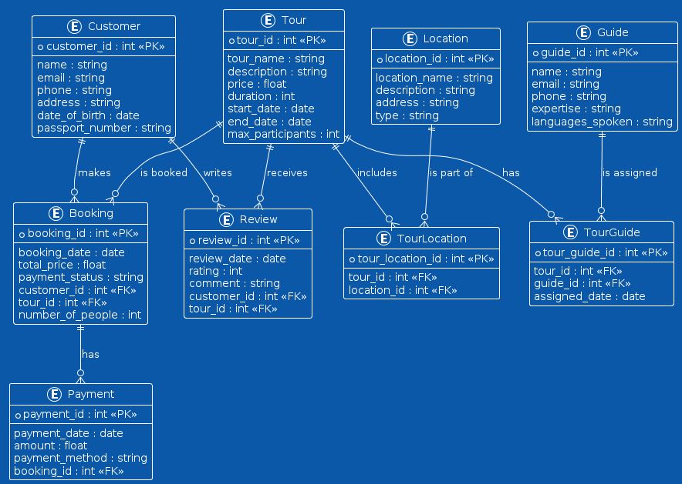
ER Diagram

Slide 7

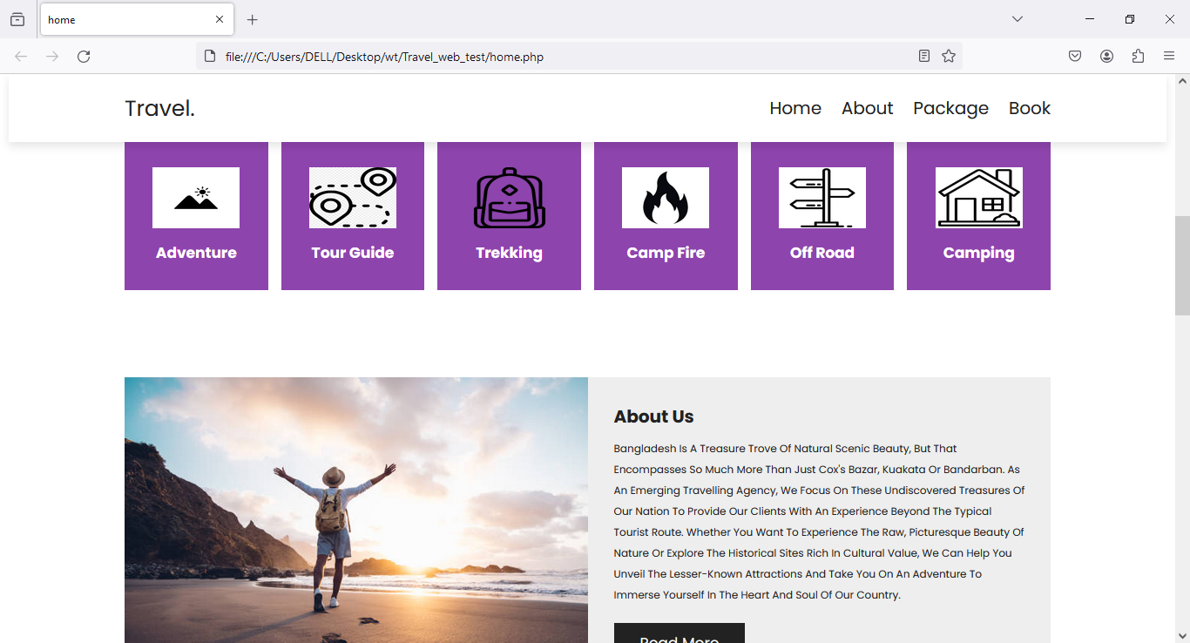
UI Design
Homepage

Slide 8

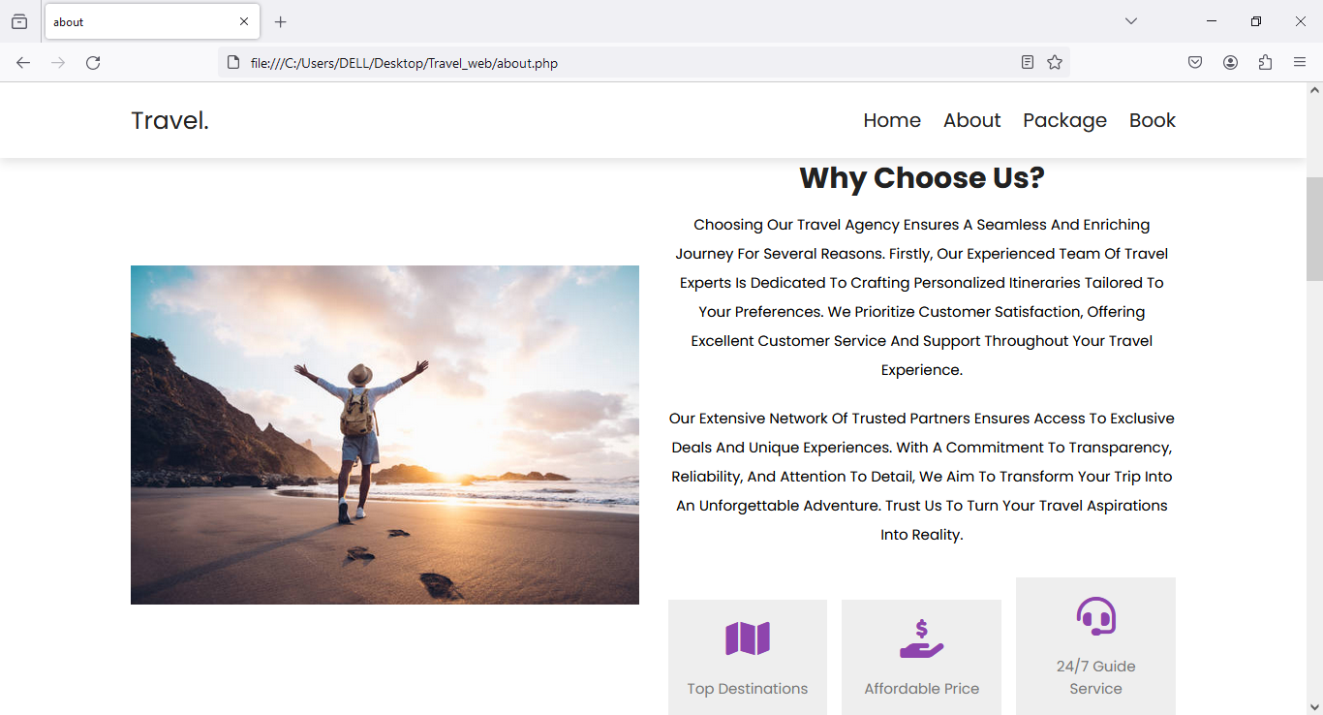

UI Design
About us

Slide 9

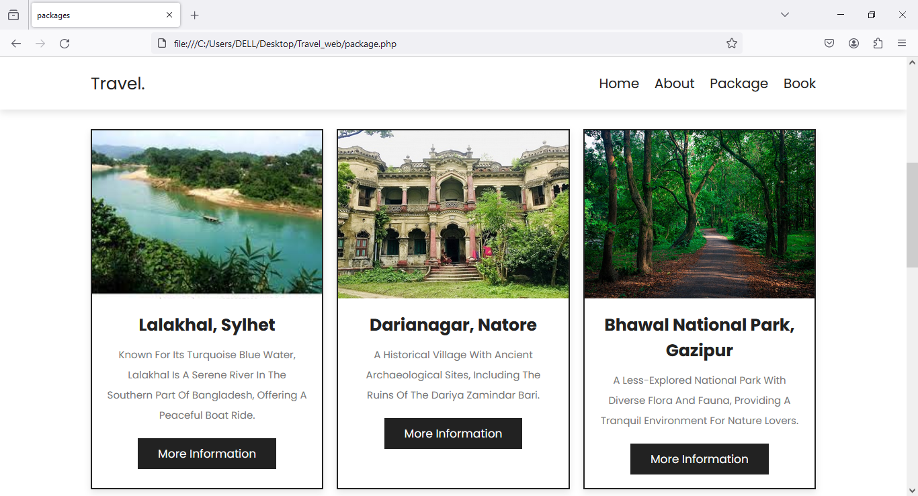
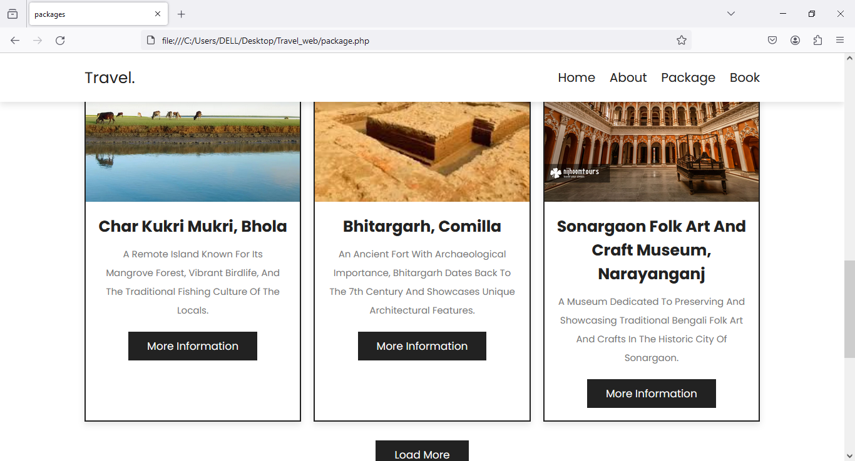
UI Design
Packages

Slide 10

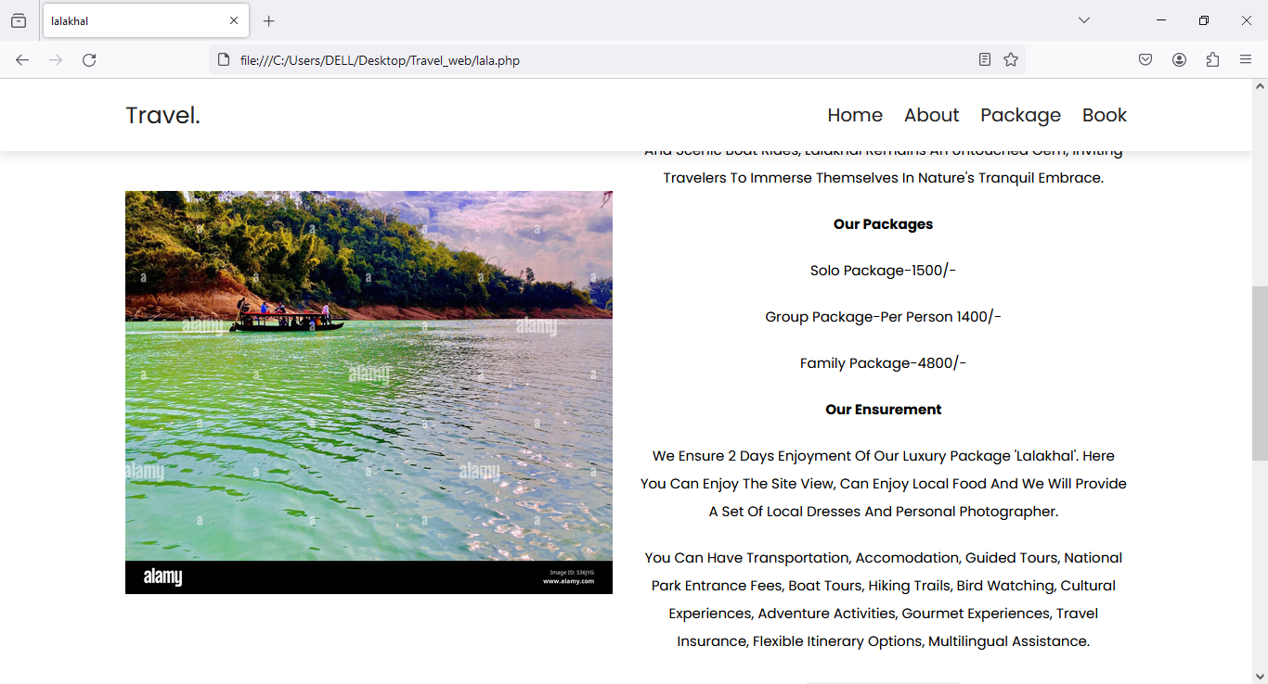
UI Design
More information

Slide 11

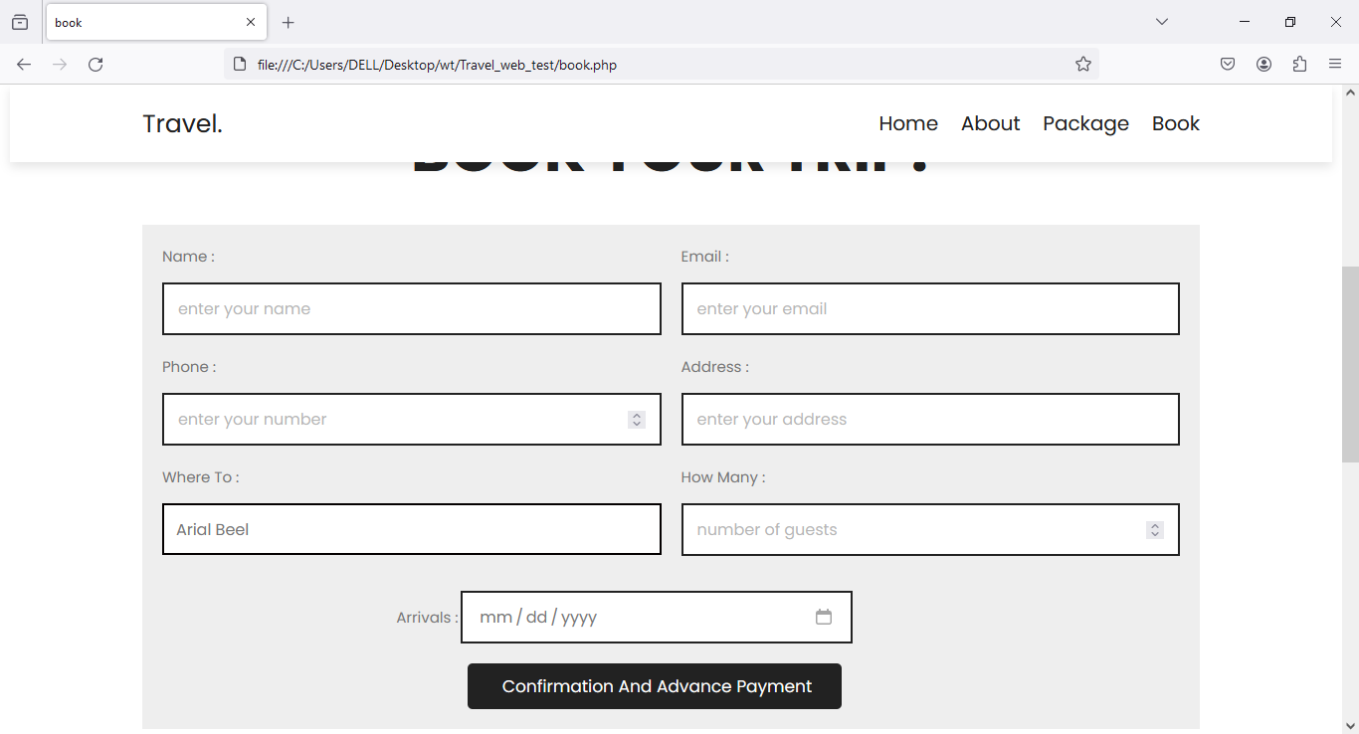
UI Design
Book

Slide 12
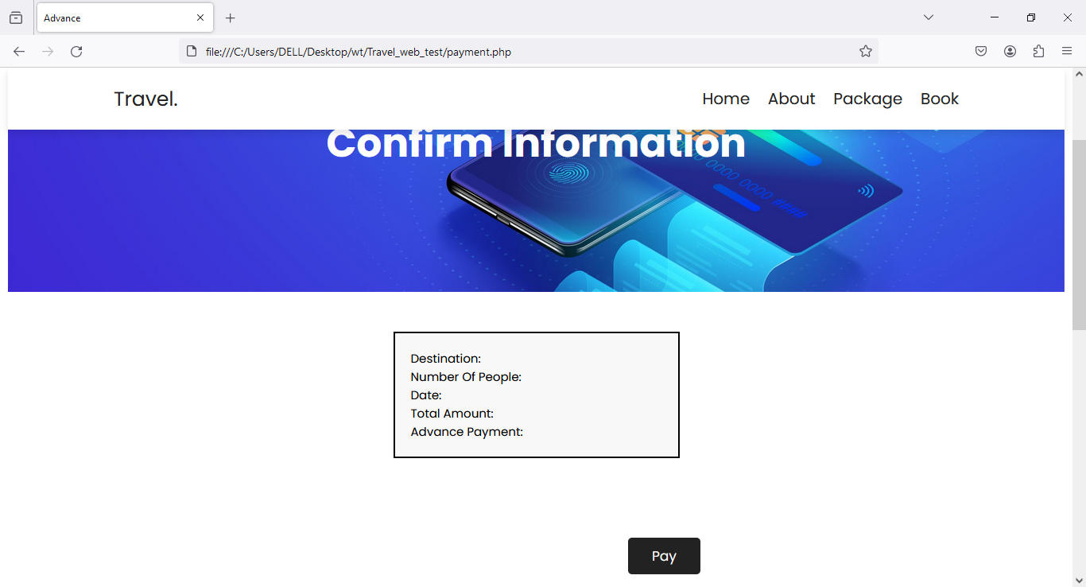
UI Design
Payment Method

Slide 13

Conclusion
"Our adventure travel website is your gateway to a world of exhilarating experiences. With a diverse range of activities and destinations, we cater to every type of traveler, from thrill-seekers to nature enthusiasts. Explore our curated selection of adventures, meticulously designed to inspire and ignite your wanderlust. Whether you're craving adrenaline-pumping escapades or serene retreats, we have something for everyone. Join us on a journey beyond the ordinary and make memories that will last a lifetime. Are you Ready to travel with us?

Slide 14
Thank you

